Slide 1
Block Diagram
CKR L-CARE Dispenser I

Slide 2

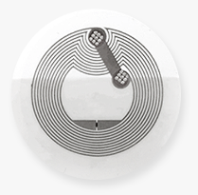
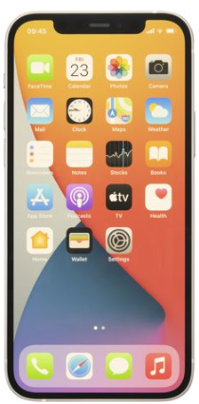
Block Diagram (NFC Reader)
Logic
Arrays(Mux)
Sub 1 PN7150
L-CARE Dispenser
NFC Tag1(NTAG)
Dose Cartridge 1
Sub 2 PN7150
NFC Tag2(NTAG)
Dose Cartridge 2
L-CARE
App
AP(Linux)
Rockchip
Main
PN7150
Sub 3 PN7150
NFC Tag3(NTAG)
Dose Cartridge 3
Sub 4 PN7150
NFC Tag4(NTAG)
Dose Cartridge 4
Sub 5 PN7150
NFC Tag5(NTAG)
Dose Cartridge 5
Sub 6 PN7150
NFC Tag6(NTAG)
Dose Cartridge 6

Slide 3
Block Diagram (New L-CARE Dispenser with NFC Reader)
L-CARE Dispenser
Sub 1
MFRC63003
NFC Tag1(NTAG)
Sub MCU
Logic Array(Mux)
Dose Cartridge 1
Sub 2
MFRC63003
NFC Tag2(NTAG)
Dose Cartridge 2
L-CARE
App
검토 중
i.MXRT101x/2x
for replacing Rockchip AP(Linux)
Sub 3
MFRC63003
NFC Tag3(NTAG)
Dose Cartridge 3
Main
PN7150
Sub 4
MFRC63003
NFC Tag4(NTAG)
Dose Cartridge 4
Sub 5
MFRC63003
NFC Tag5(NTAG)
Dose Cartridge 5
QSPI Flash
MXIC
Sub 6
MFRC63003
NFC Tag6(NTAG)
UWB
SR040NH/B022CY
Dose Cartridge 6
BLE
QN9090HN
or
UWB
SR150UK/B22BA
MX25R1635F

