Slide 1
Qualcomm Automotive Modules
Feb. 27, 2023
OSCO Co., Ltd.

Slide 2
Agenda
Qualcomm Automotive Modules
QAM8295P high-level block diagram
SA8295P Automotive Development Platform(ADP)
Automotive Linux SW Stack on Qualcomm
Work Scope(SW)
Summary
3
4
5
6
7
8

Slide 3
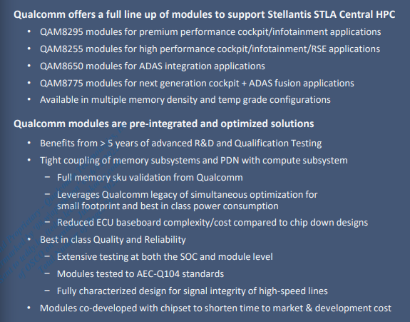
Qualcomm Automotive Modules
Next level of integration for advanced cockpit and ADAS applications
Designs Complexity increasing at an unprecedented rate and involves extensive modeling and simulation
Optimum Design for Performance and Power require tight integration with and between silicon components
Extensive testing on a single design and resolution of common issues seen across multiple customer designs
High Speed I/O and memory interfaces make Signal Integrity & Product Validation more critical than ever
Consistent Performance best done through optimized, reusable, modular sub-systems
Leverage the buying power of Qualcomm for reduced cost

Slide 4
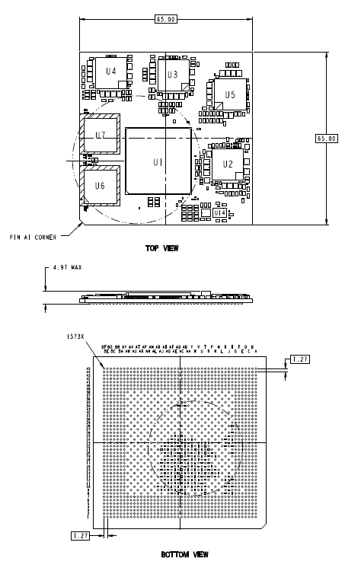
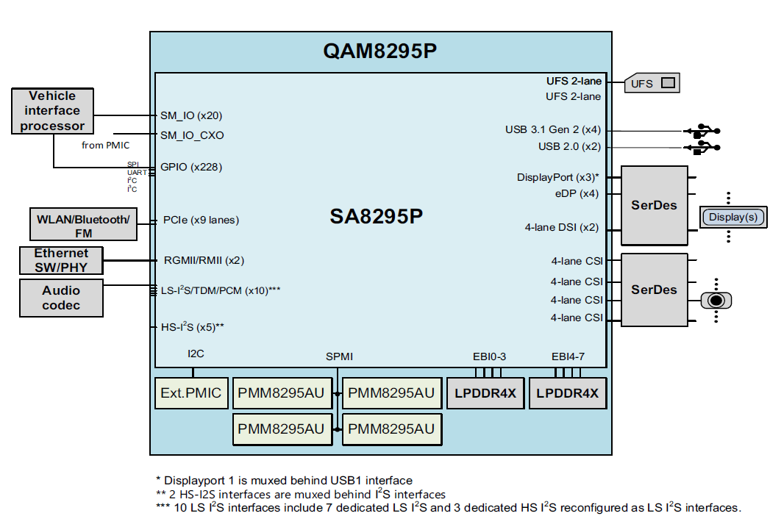
QAM8295P high-level block diagram
SA8295P : U1
PMM8295AU: U2, U3, U4, U5
LPDDR4X : U6, U7

Slide 5
SA8295P Automotive Development Platform(ADP)
Storage
QAM8295P

Slide 6
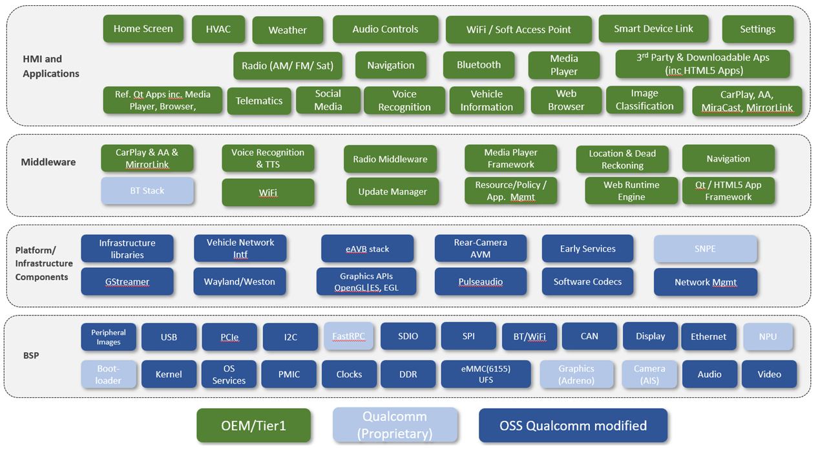
Automotive Linux SW Stack on Qualcomm

Slide 7

Work Scope(SW)
 | Qualcomm | OEM / 3rd Party | UNI. Group
Middleware / Application Solutions
Qualcomm(Proprietary) - Camera(AIS, ISP) / GPU(Adreno) / NPU(SNPE) / FastRPC
Boot KPI, DSP(Algorithm, Audio Tuning)
Security
BSP modified by Qualcomm
Device Driver Porting
<Note>
FastRPC : Qualcomm-proprietary Remote Procedure Call mechanism between Cores

Slide 8
Summary
What will we do for QAM Biz?
Challenge | Comment
B Technical support from Qualcomm | It’s not easy to drive Qualcomm’s R&D team to support our SMALL customers. Qualcomm is supporting the BIG customers - for example, LG, HKMC, MOBIS, MANDO, YURA, SL, etc. - directly when a project contract is completed.
C Finding the add-on business model | It’s judged that there is no difference from the current business model. OSCO is acting as a distributor along with Qualcomm to support the customer’s project. Refer to our work scope on page 7.
D Increasing S/W Capability - Linux/Android, Hypervisor(QNX, Green Hills, Open Synergy), LXC | It depends on the customer’s requirements.

