Slide 1
i.MX 8M Plus
Applications processor
6-Pack Presentation
Adrienne Suner, Product Manager
Commercial & Industrial Launch – March 16, 2021

Slide 2
i.MX 8M Family of Applications Processors
i.MX 6QuadPlus
A72
A53
M4
Now
i.MX 8 Family
i.MX 8M Plus
2.3TOP NPU, Vision (ISP), 1080p video encode/decode, advanced HMI, multi-display USB3/2xGbE/PCIe
i.MX 6Quad
A9
Advanced Graphics, Vision & Performance
i.MX 6DualPlus
i.MX 8M Family
General Purpose
Edge Processing
Pin-to-pin Compatible
i.MX 6Dual
Now
A53
M4/M7
i.MX 8M
4K HDR, 4K video decode, advanced HMI, multi-display USB3/GbE/2xPCIe
i.MX 6DualLite
i.MX 6Solo
Software Compatible
A9
M4
i.MX 8X Family
A35
M4
i.MX 8M Mini
Versatile multimedia applications processor with 1080p video encode/decode, HMI graphics acceleration, USB/GbE/PCIe
Now
i.MX 6SoloX
Safety Certifiable &
Efficient Performance
Software Compatible
i.MX 6SoloLite
Arm ® v8-A (32-bit/ 64-bit)
i.MX 6SLL
i.MX 7 Family
A7
M4
i.MX 6UltraLite
Flexible Efficient Connectivity
Pin-to-pin Compatible
Now
i.MX 6ULL
A7
i.MX 8M Nano
Entry-level multimedia applications processor with HMI graphics acceleration, USB/GbE
i.MX 7ULP Family
A7
M4
i.MX 6ULZ
Ultra-Low Power with Graphics
Arm® v7-A (32-bit)
Arm® v7-A
Notes:
NXP launches its fourth member of the i.MX 8M family, the i.MX 8M Plus applications processor. Built in high-performance and power-efficient 14FinFET technology, it brings scalable and secure quad-core processing to edge IoT devices.
The feature set includes:
Powerful Quad or Dual Arm® Cortex®-A53 processor
Neural Processing Unit (NPU) operating at up to 2.3 TOPS.
Dual Image Signal Processors and two camera inputs for an effective Vision System.
The multimedia capabilities include video encode and decode (including h.265),
3D/2D graphic acceleration, and multiple audio and voice functionalities.
Real-time control with Cortex®-M7.
Robust control networks supported by dual CAN and dual Gigabit Ethernet with Time Sensitive Networking (TSN).
High industrial reliability with DRAM inline ECC.
The i.MX 8M Plus family focuses on machine learning and vision, advanced multimedia, and industrial IoT with high reliability. It is built to meet the needs of Smart Home, Building, City and Industry 4.0 applications. The new devices include:
The i.MX 8M Plus Quad which integrates four Arm Cortex-A53 cores, one Cortex-M7 core, an NPU, dual ISP, HiFi 4 DSP, and 2D/3D GPU.
The i.MX 8M Plus QuadLite which integrates four Arm Cortex-A53 cores, and one Cortex-M7 core.
The i.MX 8M Plus Dual which integrates two Arm Cortex-A53 cores, one Cortex-M7 core, an NPU, dual ISP, HiFi 4 DSP, and 2D/3D GPU.

Slide 3

i.MX 8M Family: Scalable broad market Solutions
i.MX 8M Quad Family
i.MX 8M Mini Family
i.MX 8M Nano Family
i.MX 8M Plus Family
A53
M4
GPU
A53
M4
GPU
A53
M7
GPU
A53
M7
NPU
DSP
GPU
Available NOW
Available NOW
Available NOW
1Q 2021
1Q 2021
i.MX 8M Quad
i.MX 8M Dual
i.MX 8M QuadLite
i.MX 8M Mini
Quad/Dual/Solo
i.MX 8M Mini
QuadLite/
DualLite/
SoloLite
i.MX 8M Nano
QuadDual/Solo
i.MX 8M Nano
QuadLite/
DualLite/
SoloLite
i.MX 8M Nano
QuadUltraLite/
DualUltraLite/
SoloUltraLite
i.MX 8M Plus
Quad/Dual
i.MX 8M Plus
QuadLite
17x17 Package
Pin Compatible 14x14 Package
11x11 Package
15x15 Package
Advanced Audio, Voice, 4K Video, HDR, 3D GPU w/ OpenCL,
Broad Connectivity
Advanced Audio, Voice, HD Video (2-way), 3D GPU, Power Efficient 14FF
Low-Cost Audio, Voice, 3D GPU w/ OpenCL, Power Efficient 14FF
Low-Cost Edge Processing, Power Efficient 14FF
ML, Vision, Industrial IoT,
Advanced Multimedia,
Voice, HD Video (2-way), 3D GPU, Power Efficient 14FF
Software Compatible (including GPU Tools)
Scalable series of FOUR Arm V8 64-bit (/32-bit) based SoC Families
Notes:
The i.MX 8M Family is a scalable portfolio that covers a wide array of applications depending on the customers’ needs.
In addition to the applications processors we have already released (i.MX 8M Quad, I.MX 8M Mini and I.MX 8M Nano), and the i.MX 8M Plus.
The i.MX 8M Plus focuses on Machine Learning, Advanced Vison, Advanced multimedia as well as Industrial automation applications.

Slide 4
i.MX 8M Family Comparison Chart
Product | i.MX 8M Quad / Quad Lite | i.MX 8M Mini / Mini Lite | i.MX 8M Nano / Nano Lite | i.MX 8M Nano UltraLite | i.MX 8M Plus
Production Status | Mass Production | Mass Production | Mass Production | 1Q2021 | 1Q2021
Main CPU | 2-4xA53 1.5GHz, 1MB L2 | 1-4xA53 1.8GHz, 512KB L2 | 1-4xA53 1.5GHz, 512KB L2 | 1-4xA53 1.4GHz, 512KB L2 | 2-4xA53 1.8GHz, 512KB L2
MCU/DSP | M4 266MHz | M4 400MHz | M7 up to 750MHz | M7 up to 750MHz | M7 800MHz, HiF i4 800 MHz
DDR | x16 or x32 LPDDR4/DDR4/DDR3L | x16 or x32 LPDDR4/DDR4/DDR3L | x16 LPDDR4/DDR4/DDR3L | x16 LPDDR4/DDR4/DDR3L | x32 LPDDR4/DDR4 Inline ECC
GPU | 3D – GC7000L (OpenGL® ES 2.1/3.0/3.1, OpenCL™ 1.2, Vulkan®) | 2D – GC320 3D – GC NanoULTRA (OpenGL ES 2.1) | GC7000UL (OpenGL ES 2.1/3.0/3.1, OpenCL 1.2, Vulkan) | - | 2D - GC520L 3D – GC7000UL (OpenGL ES 2.1/3.0/3.1, OpenCL 1.2, Vulkan)
Security | CAAM, RDC, Arm® TrustZone® | CAAM, RDC, Arm TrustZone | CAAM, RDC, Arm TrustZone | CAAM, RDC, Arm TrustZone | CAAM, RDC, Arm TrustZone
AI/ML | OpenCL CPU: 32 GOPS | A53 | OpenCL CPU, GPU: 32 GOPS | A53 | ML Accel 2+ TOPS
SRAM | 128KiB + 32KiB | 256KiB + 32KiB | 512KiB + 32KiB | 512KiB + 32KiB | 768KiB + 32KiB
Camera | 2x MIPI CSI (4-lane) | 1x MIPI CSI (4-lane) | 1x MIPI CSI (4-lane) | 1x MIPI CSI (4-lane) | 2x MIPI CSI (4-lane), 2 ISPs (3-exposure HDR)
Display | HDMI 2.0a Tx, MIPI DSI (4-lane), eDP; HDR10, HLG, Dolby Vision | 1x MIPI DSI (4-lane) | 1x MIPI DSI (4-lane) | - | HDMI 2.0a Tx (eARC), MIPI DSI (4-lane), 1x LVDS (8-lane)
OSD Overlay | 4Kp60 | 1080p60 | 1080p60 | - | 4Kp30
Video Decode | 4Kp60 HEVC, VP9, 4Kp30 H.264, legacy codecs | 1080p60 HEVC, H.264, VP9, VP8 | None | None | 1080p60 H.265, H.264, VP9, VP8
Video Encode | None | 1080p60 H.264, VP8 | None | None | 1080p60 H.265, H.264
Connectivity | PCIe, SDIO, USB | PCIe, SDIO, USB | SDIO, USB | SDIO, USB | PCIe, SDIO, USB
Audio | 20x I2S TDM (32b @384KHz), S/PDIF Tx+Rx | 20x I2S TDM (32b @384KHz), 8ch PDM DMIC input, S/PDIF Tx+Rx | 12x I2S TDM (32b @384KHz), ASRC, 8ch PDM DMIC input, S/PDIF Tx+Rx | 12x I2S TDM (32b @384KHz), ASRC, 8ch PDM DMIC input, S/PDIF Tx+Rx | 18x I2S TDM (32b @384KHz), ASRC, 8ch PDM DMIC input), S/PDIF Tx+Rx
Expansion I/O | 2x USB3.0, 2x PCIe Gen 2 | 2x USB2.0, 1xPCIe Gen 2 | 1x USB2.0 | 1x USB2.0 | 2x USB 3.0, 1x PCIe Gen 3
Network, Storage | 1x GbE, 2x SD/eMMC, MLC/SLC NAND | 1x GbE, 3xSD/eMMC, MLC/SLC NAND | 1x GbE, 3xSD/eMMC, MLC/SLC NAND | 1x GbE, 3x SD/eMMC, MLC/SLC NAND | 2x GbE (1x TSN), 2x CAN-FD, 3x SD/eMMC, MLC/SLC NAND
Process | 28nm | 14nm FinFET | 14nm FinFET | 14nm FinFET | 14nm FinFET
Package | 17x17mm, 0.65mm | 14x14mm, 0.5mm de-pop | 14x14mm, 0.5mm de-pop | 11x11mm, 0.5mm de-pop | 15x15mm, 0.5mm de-pop
Pin Compatible
Highlighted Feature
Notes:
The i.MX 8M Family of applications processor portfolio is comprised of 18 devices. Each device is offered in commercial or industrial versions, and some that enable third-party IP like Dolby® Vision, Dolby ATMOS and DTS. For the i.MX 8M Mini and I.MX 8M Nano, all devices are pin and software compatible within the same 14x14 mm package. On this slide, blue text highlights differences between the i.MX 8M Quad, i.MX 8M Mini, i.MX 8M Nano, and i.MX 8M Plus applications processors.
Advantages / Highlights of the i.MX 8M Plus product:
Quad/ Dual Cortex-A53 cores running up to 1.8GHz
Cortex-M7 running up to 800MHz and HiFi 4 DSP also running up to 800 MHz
Integrated Neural Processing Unit for ML acceleration with up to 2.3TOPS
HDMI with Enhanced Audio Return Channel (eARC)
Multiple displays including MIPI-DSI, LVDS and HDMI, supporting up to 2x 1080p60 or 1x 4kp30
1080p60 H.265 and H.264 video encode and decode
PCIe Gen3, SDIO, and USB
2x Gigabit Ethernet (1 with TSN), CAN FD, SD/eMMC
14nm FinFET technology

Slide 5
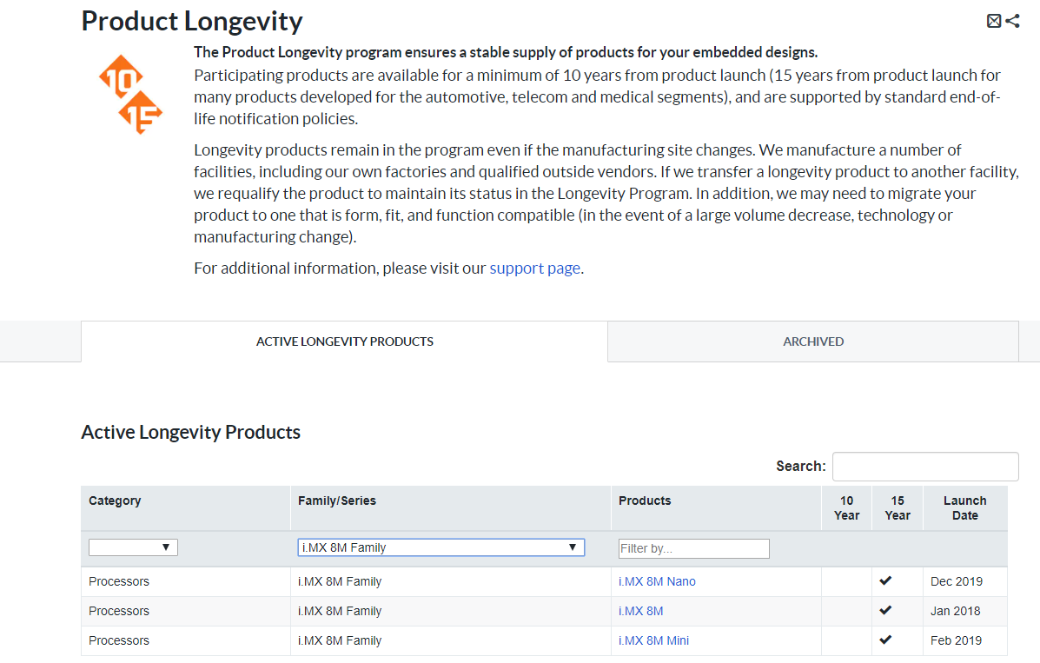
i.MX 8M Added to 15yr Longevity Program!
https://www.nxp.com/product-longevity
Product longevity increased from 10 yrs to 15 yrs!
Notes:
The i.MX 8M Family has been added to NXP’s Longevity Program supporting 15 years of longevity ensuring a stable supply of products for your embedded designs.

Slide 6

i.MX 8M Plus of Applications Processors
The i.MX 8M Plus family of processors is based on Arm® Cortex®-A53 and Cortex-M7 cores and delivers a new level of:
Machine Learning and Vision System
Advanced Multimedia
Industrial Networking and High Reliability
It is well suited for applications as:
Smart Home, Building, Retail and City
Smart Factory and Industry IoT
Machine Learning & Vision, Advanced Multimedia, Industrial IoT
Notes:
The i.MX 8M Plus is NXP’s first device within the i.MX Family with an integrated Neural Processing Unit (NPU) – a machine learning accelerator running at up to 2.3 TOPS. The i.MX 8MPlus also has as dual integrated ISPs (Image Signal Processors) for advanced vision system.
With its features, the i.MX 8M Plus is well suited for Machine Learning and Advanced Vision Systems, Advanced Multimedia, Industrial Networking and High Reliability applications and segments such smart home, building, retail and city as well as smart factory and industrial IoT.

Slide 7
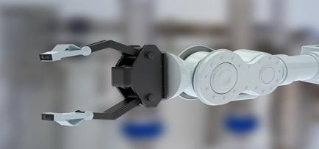

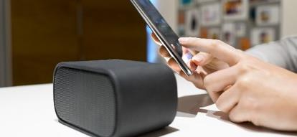
i.MX 8M Plus Target Applications
Machine Learning & Industrial Automation
Smart Home, Building & City
Consumer & Pro
Audio/Voice Systems
Machine Vision and Robot Controller
Industrial Computer, Gateways, HMI
Printers and Scanners
Machine Visual Inspection
Factory Automation
Safety, Security and Surveillance
Fleet Analytics
Traffic Monitor and Flow Optimization
Vision Payment Systems
Targeted Advertisement
Service Drones
Alarm and AI Server Hubs
Home Patient and Elderly Monitor
Surround sound and sound bars
Audio/video receiver
Immersive Audio Products
Wireless or networked smart speakers
Personal Assistant
Voice-assisted products
Notes:
Here are some of the target applications of the i.MX 8M Plus applications processors.

Slide 8
i.MX 8M Plus Key Features
High-Performance
Power-Efficient
Machine Learning,
Vision & Voice
Advanced
Multimedia
Connectivity
& Interfaces
High-Performance
Dual/Quad-core Cortex-A53 cores up to 1.8 GHz;
Cortex-M7 up to 800MHz (task offload, power optimizations)
3D GPU and VPU enables efficient video and display
DDR4, LPDDR4
(Inline ECC)
Power-Efficiency
Dynamic Voltage Frequency Scaling (DVFS), power gating, clock gating.
Built in 14nm FinFET LPC technology for low-power & high-performance
Machine Learning
Neural Network Accelerator up to 2.3 TOPS
Vision System
2x MIPI-CSI (4-lane) with PHY
Camera ISP: 2x187MPix or 1x375MPix scale, de-warp
Low-Power Voice
Low Power Voice Accelerator
Video:
1080p60 video decoding (H.265, H.264, VP9, VP8)
1080p60 video encoding (H.265, H.264)
2D and 3D GPU
Audio:
18x I2S TDM (32-bit @ 768KHz),
DSD512,
SP/DIF Tx + Rx
8-ch PDM Mic input
HDMI 2.0b Tx + eARC
ASRC
8ch PDM DMIC input for
voice capture
Display Interfaces
1x MIPI-DSI
1x HDMI 2.0b Tx (+eARC)
LVDS (4/8-lane) Tx
Up to 3 display simultaneously
High Speed Interfaces
3x SDIO 3.0 for boot / storage / Wi-Fi (max flexibility)
1x PCIe 3.0 to connect to high-performing Wi-Fi solutions and other systems
2x Gigabit Ethernet with IEEE 1588, AVB (one with TSN, one with IEEE)
2x USB 3.0/2.0 OTG with PHY
2x CAN or CAN FD
Notes:
The i.MX 8M Plus has several key features that address different market needs.
Built in 14nm FinFET technology, the i.MX 8M Plus features dual or quad Cortex-A53 cores up to 1.8 GHz, a Cortex-M7 running up to 800MHz which can be used to offload tasks as well as 3D GPU enabling efficient video and display.
For machine learning and advanced voice and vision applications, i.MX 8M Plus also features 2 ISPs, 2x MIPI-CSI and the integrated Neural Processing Unit that can run up to 2.3 TOPS for inferencing on the edge.
For Advanced Multimedia, the i.MX 8M Plus supports 1080p60 H.265 video encode and decode, 2D and 3D GPUs as well as eARC and ASRC for audio applications.
The i.MX 8M Plus also supports several high-speed interfaces such as 1x PCIe 3.0, 2x CAN FD, 2x USB 3.0/2.0 and 2x Gigabit Ethernet (one with Time Sensitive Networking).

Slide 9
i.MX 8M Plus – Features / Benefits
 | Capability | Feature | Benefits
Machine Learning | Machine Learning | Neural Processing Unit (NPU) up to 2.3 TOPS | Edge Inference and intelligence No cloud dependency, privacy, better user experience
 | Vision System | Up to 2 cameras (2x MIPI-CSI), 1080p60; Image Signal Processor (ISP) up to 375MPix/s, HDR, de-warp | 4K Vision / 1080p Stereo Vision. HDR extracts the maximum image details in high contrast scenes De-Warp: Fisheye lens correction reduce overall optical system cost
 | Voice | Low Power Voice Accelerator, 8ch-PDM digital microphone input. | Voice systems processed at the edge. Privacy, better user experience, no cloud dependency Low noise and cost-effective microphone system
Advanced Multimedia | HD Video | 1080p60 video decoding, (H.265) 1080p60 video encoding, (H.265) | High resolution video compression for cloud upload or local storage H.265 compression is twice more effective than H.264
 | 3D/2D Graphics | 2D and 3D GPU - 1Gpix/s | 3D and 2D graphics for rich HMI and user experience
 |  | OVG 1.1, OGLES 3.1, Vulkan, OCL 1.2 FP | Vulkan requirement for Android 10 onwards
 | Advanced Audio | 18x I2S TDM, DSD512, SP/DIF Tx + Rx, 8-ch PDM | Latest audio technology including Immersive audio support eARC for high-quality audio for cost-optimized soundbars
 |  | HDMI 2.0b Tx + eARC, ASRC
Industrial Network & Reliability | Industrial Network | 2x Gigabit Ethernet (1x w/ TSN) 2x CAN-FD | Low latency industrial network for precise control robust industrial control network Gateway application with dual Ethernet.
 | Memory Reliability | ECC in L2, In-line ECC on DDR bus 14FF process | High Industrial system reliability for Safety Industrial Level SIL3. Low SER rates
 | Real time Processing | Cortex-M7 @800MHz | High real-time processing power, Cortex-A complex off loading Eliminating an external MCU
Performance & Connectivity | High Performance Low power | 4x CortexA53 @1.8GHz, 14nm FinFET, Low Power, high performance | Applications running <2.0W. Deep Sleep Mode < 20mW
 | Display Interfaces | MIPI-DSI, HDMI 2.0b, LVDS 4/8-lane, supports 2x1080p60 or 1x4kp30 | Multiple display interface options working simultaneously.
 | High-Speed Interfaces | 2xUSB 3.0 (5Gb/s each) PCIe 3.0 3x SDIO 3.0 800Mb/s | Fast connections to Wi-Fi, FPGAs, co-processors. Fast data transfer, e.g., media files
Notes:
The following chart shows additional benefits of the i.MX 8M Plus features depending on different capabilities that will suit the customers’ application.

Slide 10
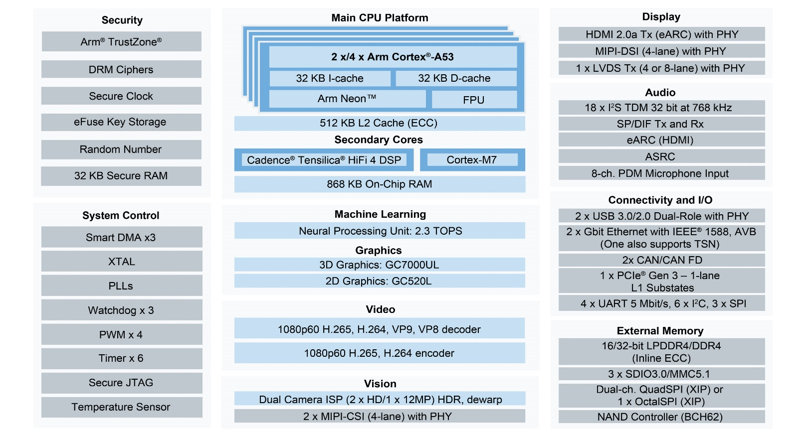
i.MX 8M Plus Applications Processor
  Feature Highlights:
  Quad Arm® Cortex-A53 up to 1.8 GHz
  Arm v8 fully 64-bit capable, 512KB L2 cache (ECC)
  Arm Cortex-M7 up to 800MHz with 512KB RAM (ECC)
  Voice Acceleration co-processor: HiFi 4 DSP up to 800MHz with 256KB RAM (ECC)
  Machine Learning accelerator: Neural Processing Unit (NPU) 2.3 TOPS performance
  Package: FCBGA 15x15mm, 0.5mm pitch, depop (consumer and industrial)
  Operating System targets: Linux OS, Android OS, HiFi4 SDK, FreeRTOS
  Qualification: Consumer (0C to +95C); Industrial (-40C to +105C)
  External memory:
    32-bit LPDDR4/DDR4 (Inline ECC)
      3x SDIO3.0/eMMC5.1
      Dual-channel QuadSPI (XIP) or 1x OctalSPI
      NAND Controller (BCH62)
      SPI NAND
  Graphics Processing Unit (GPU):
    GC7000UL (3D GPU, 2-shaders, OpenGL® ES 3.1, Vulkan®, Open CL™ 1.2 FP)
      GC520L (2D GPU, OpenVG™ 1.1)
  Video Processing Unit (VPU):
    Decode: 1080p60 H.265, H.264, VP9, VP8
      Encode: 1080p60 H.265, H.264
  Display controllers (up to 3 simultaneous displays):
      1x HDMI 2.0a Tx (eARC) with PHY
      1x LVDS Tx (4 or 8-lane) with PHY
      1x MIPI-DSI (4-lane) with PHY
  Vision:
    Camera (up to 2 cameras): 2x MIPI-CSI (4-lane) with PHY
      Image Signal Processor (ISP): 12MP resolution, 2x187MP or 1x375MP input rate, 3-exposure HDR, Dewarp
  Audio:
    18x I²S TDM (32-bit @ 768KHz), DSD512, SP/DIF Tx + Rx
      8 channel PDM microphone input
      eARC, ASRC
  Connectivity and I/O:
    2x USB 3.0/2.0 Type C with PHY
    1x PCIe Gen 3.0 (1 lane) with L1 Substates for fast wake from low power mode
    2x Gigabit Ethernet with IEEE 1588, EEE and AVB (one with TSN, but no EEE)
    2x CAN/CAN FD
i.MX 8M Plus

Slide 11
i.MX 8M Plus Configurations
Streaming Media
Voice Assistants
AI, Machine Learning
Industrial IoT
Edge Compute
Machine Vision
Part Number | Sub Family | Application Requirements | Arm CPU | NPU | ISP | Video | HiFi4 DSP | Temp (C) | CAN-FD | Family Common Features
MIMX8ML8DVNLZAB | i.MX 8M Plus Quad | Machine Learning, Vision & Video | 4x Cortex-A53 Up to 1.8GHz | 2.3 TOPS | 12MP resolution Up to 375MP/s | Decode: 1080p60 (h.265/4, VP8/9) Encode: 1080p60 (h.265/4) | YES | 0 - 95 | 2X CAN | Cortex-M7 @800MHz GPU OpenVG 1.1, G2D, OpenGL ES3.1 Vulkan, OpenCL 1.2 FP Display/Camera HDMI Tx, LVDS, MIPI-DSI 2X MIPI-CSI Connectivity 2x USB 3.0, PCIe Gen3 2x Gb Ethernet (1x TSN) 3x SDIO Audio 18x I2S TDM (32b@768KHz) SP/DIF Rx & Tx, eARC ASRC, 8ch PDM
MIMX8ML8CVNKZAB | i.MX 8M Plus Quad |  | 4x Cortex-A53 Up to 1.6GHz |  |  |  |  | -40 - 105 | 2X CAN-FD
MIMX8ML6DVNLZAB | i.MX 8M Plus Quad | Vision &Video | 4x Cortex-A53 Up to 1.8GHz | _ | 12MP resolution Up to 375MP/s | Decode: 1080p60 (h.265/4, VP8/9) Encode: 1080p60 (h.265/4) | _ | 0 - 95 | 2X CAN
MIMX8ML6CVNKZAB | i.MX 8M Plus Quad |  | 4x Cortex-A53 Up to 1.6GHz |  |  |  |  | -40 - 105 | 2X CAN-FD
MIMX8ML4DVNLZAB | i.MX 8M Plus QuadLite | Compute & High-speed Industrial Interfaces | 4x Cortex-A53 Up to 1.8GHz | _ | _ | _ | _ | 0 - 95 | 2X CAN
MIMX8ML4CVNKZAB | i.MX 8M Plus QuadLite |  | 4x Cortex-A53 Up to 1.6GHz |  |  |  |  | -40 - 105 | 2X CAN-FD
MIMX8ML3DVNLZAB | i.MX 8M Plus Dual | Machine Learning, Vision & Video | 2x Cortex-A53 Up to 1.8GHz | 2.3 TOPS | 12MP resolution Up to 375MP/s | Decode: 1080p60 (h.265/4, VP8/9) Encode: 1080p60 (h.265/4) | YES | 0 - 95 | 2X CAN
MIMX8ML3CVNKZAB | i.MX 8M Plus Dual |  | 2x Cortex-A53 Up to 1.6GHz |  |  |  |  | -40 - 105 | 2X CAN-FD
Software, Package, and Pin Compatible
Notes:
The i.MX 8M Plus applications processor is comprised of 8 devices, Each device is offered in commercial or industrial versions. All parts are pin and software compatible within the same 15x15 mm package.
i.MX 8M Plus Quad (ML8 version)– Flagship full-featured product, contains 4x Arm Cortex-A53 cores running up to 1.8 GHz per core, 1x Arm Cortex-M7 core running up to 800 MHz per core, NPU, dual ISP, HiFi 4 DSP, video encode and decode, as well as 2D and 3D GPU. Available in commercial (0C to +95C, 1.8 GHz per Arm Cortex-A53) and industrial (-40C to +105C, 1.8 GHz per Arm Cortex-A53) versions.
i.MX 8M Plus Quad (ML6 version)– contains 4x Arm Cortex-A53 cores running up to 1.8 GHz per core, 1x Arm Cortex-M7 core running up to 800 MHz per core, dual ISP, video encode and decode, as well as 2D and 3D GPU. Available in commercial (0C to +95C, 1.8 GHz per Arm Cortex-A53) and industrial (-40C to +105C, 1.8 GHz per Arm Cortex-A53) versions.
i.MX 8M Plus QuadLite – contains 4x Arm Cortex-A53 cores running up to 1.8 GHz per core and 1x Arm Cortex-M7 core running up to 800 MHz per core. Available in commercial (0C to +95C, 1.8 GHz per Arm Cortex-A53) and industrial (-40C to +105C, 1.8 GHz per Arm Cortex-A53) versions.
i.MX 8M Plus Dual – contains 2x Arm Cortex-A53 cores running up to 1.8 GHz per core, 1x Arm Cortex-M7 core running up to 800 MHz per core, NPU, dual ISP, HiFi 4 DSP, video encode and decode, as well as 2D and 3D GPU. Available in commercial (0C to +95C, 1.8 GHz per Arm Cortex-A53) and industrial (-40C to +105C, 1.8 GHz per Arm Cortex-A53) versions.

Slide 12
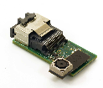
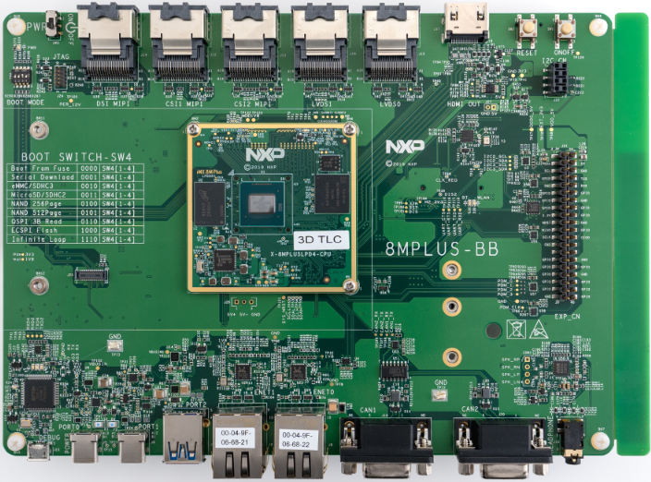
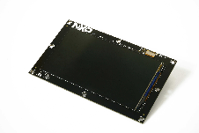
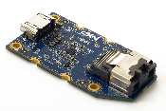
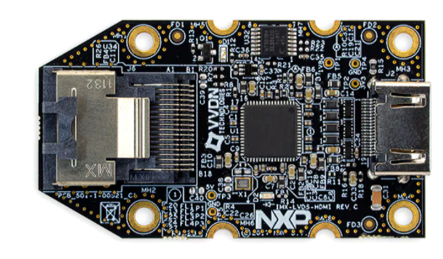
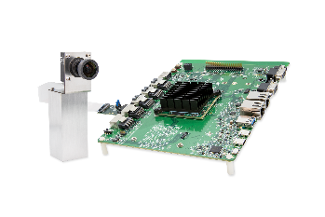
Enablement | 8MPLUSLPD4-EVK
Base Kit: Compute Module + Base Board
Optional Add-ons
Base Board: Overview
MiniSAS Display Connectors
  1x MIPI-DSI
  2x LVDS
MiniSAS Camera connectors
  2x MIPI-CSI
1x HDMI2.0
Audio CODEC
  headphone jacks
1x micro-SD card slot
2x 10/100/1000 Ethernet port (1x w/ TSN)
USB 3.0 Type C for power
1x USB 3.0 Type A
1x USB 3.0 Type C
1x M.2 Key-E slot
  PCIe+SDIO+UART+PCM
  PCIE Wi-Fi/Bluetooth Module: AzureWave AW-CM276MA (NXP 88W8997) Wi-Fi 5 (802.11ac) 2x2 Dual-Band (2.4/5 GHz), Bluetooth 5.1
General purpose expansion connector (RPI-like): UART, I2C, SPI, PCM, PWM
2x DB9 CAN-FD
10-pin JTAG
Micro USB for console
Target Size 8” x 6”
Kit Contents
i.MX 8M Plus CPU module
Base board
Quick Start Guide
USB Type-C to Type-A adapter
USB 3.0 to Type C cable.
USB A to micro-B cable
USB Type C power supply.
Compute Module: Overview
NXP i.MX 8M Plus
PMIC NXP PCA9450C
6GB LPDDR4;16 GB eMMC5.1
32MB QSPI Flash
Target: 6-layer PCB no HDI
Target Size: 2.3”x2.3”
OS Support
Linux®, Android™ and FreeRTOS
BSPs from NXP
Others: 3rd parties
MIPI CSI Board
miniSAS based
MINISASTOCSI
OLED MIPI DSI Board
miniSAS based
MX8-DSI-OLED1/
MX8-DSI-OLED1A
MIPI-DSI to HDMI
miniSAS based
IMX-MIPI-HDMI
LVDS to HDMI
miniSAS based
IMX-LVDS-HDMI
Part Numbers:
8MPLUSLPD4‐EVK
i.MX 8M Plus Reference
Camera module
108225
Notes:
The i.MX 8M Plus evaluation kit is a feature-rich and excellent starting point for customers to create their own system design based on the i.MX 8M Plus applications processor. It is orderable and shipping. Part number is 8MPLUSLPD4-EVK and it re-sales for $449.
The i.MX 8M Plus evaluation kit is a two-board solution that consists of a compact compute module and a larger base board that brings out the broad connectivity that is needed for product evaluation. The compute module uses fast, power-efficient 6GB of LPDDR4 memory alongside the i.MX 8M Plus applications processor, PMIC, eMMC, and M.2 connected Wi-Fi/Bluetooth module for connectivity out-of-the-box.
The EVK enables HDMI via the HDMI port on the base board or through an optional MIPI-DSI to HDMI accessory card for simple out-of-the-box bring up.
Key Features of the i.MX 8M Plus EVK:
The compute module is a compact 2.3” x 2.3” design in 6 layers and consists of the key system components – SoC, PMIC, Memory, Flash and Wi-Fi/Bluetooth for connectivity. The compute module uses 6GB LPDDR4. An Azurewave module (AW-CM276MA) is used for the Wi-Fi/Bluetooth which also features the NXP 88W8997.
The base board brings out all the key interfaces – USB, MIPI-DSI, MIPI-CSI, LVDS, HDMI, microSD, Ethernet, along with expansion headers such as M.2, audio, and general purpose (UART, I2C, I2S, PCM, PWM etc.).

Slide 13
i.Mx 8m plus applications processor | summary
Quad and Dual-core Arm® Cortex®-A based applications processor for Machine Learning & Vision, Advanced Multimedia, and Industrial Networking and High Reliability
Performance​
  Up to 1.8 GHz Arm® Cortex®-A53
  Up to 800 MHz Cortex-M7 with 512KB RAM (ECC)
Advanced Vision and Machine Learning
  Integrated ISP
  Neural Processing Unit (NPU) with up to 2.3 TOPS
Industrial Networking and High Reliability
  Time Sensitive Networking (TSN)
  CAN-FD
Advanced Multimedia
  3D (GC7000UL) and 2D GPU (GC520L)
  Video encode: 1080p60 H.265, H.264
  Video decode: 1080p60 H.265, H.264, VP9, VP8
Rich Feature Set
  32-bit LPDDR4/DDR4
  2x MIPI CSI
  2 x Gbps Ethernet (1x with TSN)
  2x USB 3.0/2.0 Type C
  PCIe Gen 3.0
Robust Ecosystem
  Graphics
  ML/AI
  SW/Tools
  Connectivity
www.nxp.com/imx8mplus
Notes:
With its high performance, advanced vision and machine learning capabilities, advanced multimedia features, robust ecosystem and product longevity, the i.MX 8M Plus is well suited for a broad spectrum of applications in both the industrial and consumer segments.

Slide 14
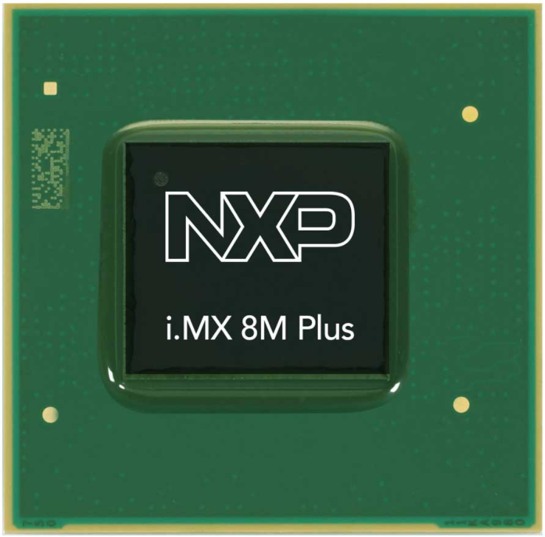
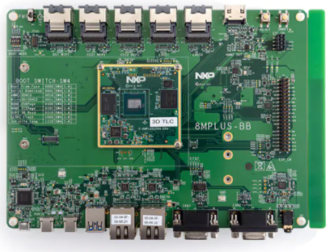



i.Mx 8m plus applications processor | More Information
www.nxp.com/imx8mplus
www.nxp.com/imx8mplusevk
Product Summary:
Fact Sheet
Product Documentation:
Datasheet
Reference Manual
Errata
Application Notes:
Power Consumption
Product Lifetime
Evaluation Kit Summary:
EVK Fact Sheet
EVK Documentation:
Quick Start Guide
EVK Hardware User’s Guide
Hardware Design:
Hardware Developer’s Guide
EVK Design Files
BSDL Files
IBIS Model
System on a Module
Partners SOMs
Board Support Package:
Software and Development Tools:
  www.nxp.com/imxlinux
  www.nxp.com/imxandroid
  https://community.nxp.com/
NXP i.MX Community
Notes:
All relevant documentation and downloads for the i.MX 8M Plus can be found on the product landing page at www.nxp.com/imx8mplus and the EVK landing page at www.nxp.com/imx8mplusevk.
Other relevant resources can be found:
https://community.nxp.com/
www.nxp.com/imxlinux
www.nxp.com/imxandroid

